Slide 1
6.8300: Prostate Cancer Diagnosis
Yen Hann Yoo, Jessie Tanaboriboon

Slide 2
Introduction
Prostate cancer → leading causes of cancer-related deaths among men
Diagnosis primarily involves an assessment of prostate biparametric MRI → Can we leverage the use of computer vision?
Related Work
3D MRI images using XmasNet, which is inspired by the VGG net, with data augmentation done through 3D rotation and slicing, which reformulate the 3D problem into 2D problem [1]
Objective
Experimented with popular pre-trained Deep Learning models for image classification to ascertain their applicability to prostate cancer detection
Comparing two different modalities of MRI images (ADC and T2W) as input
Motivation
Explore whether it is possible to only use 1 image modality to detect clinically significant prostate cancer to simplify decision making process
[1] https://arxiv.org/abs/1703.04078

Slide 3
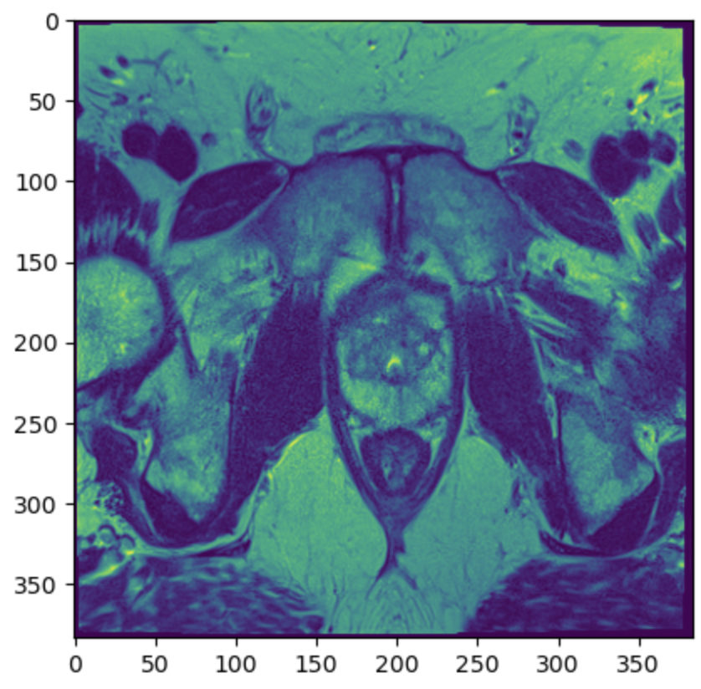
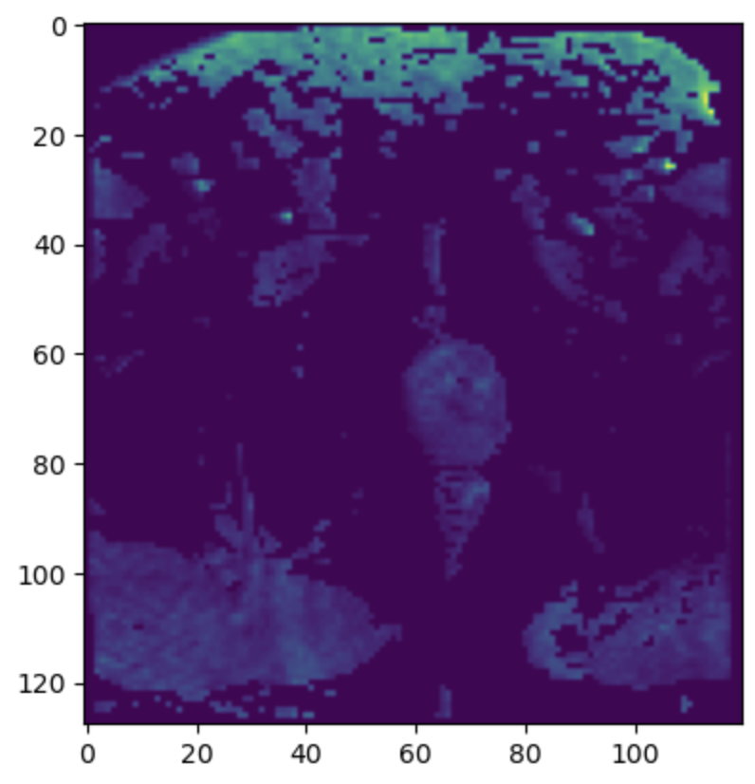
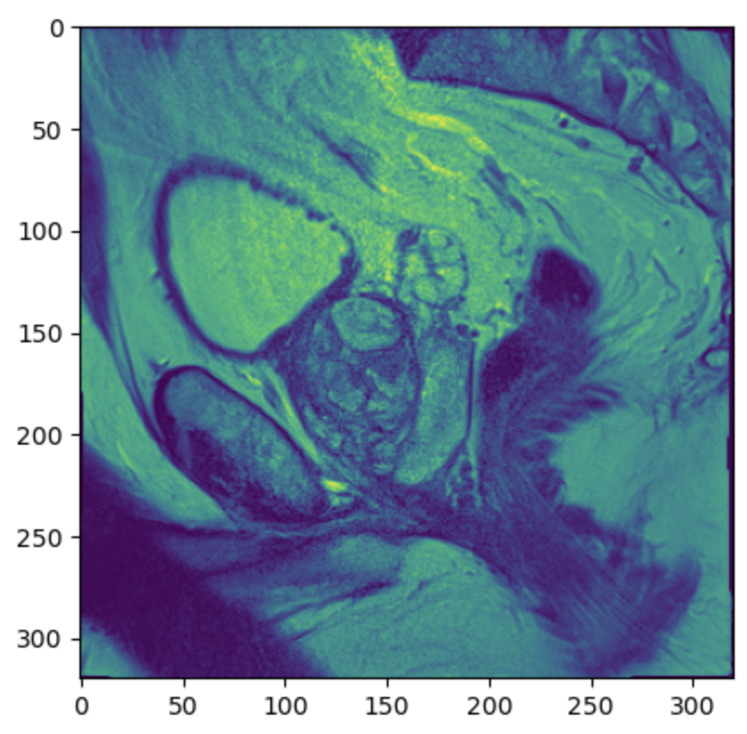
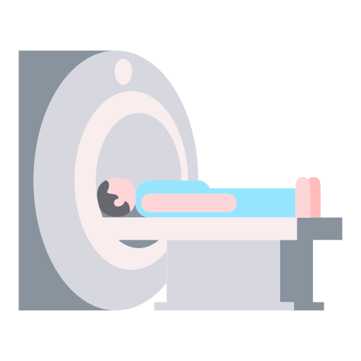
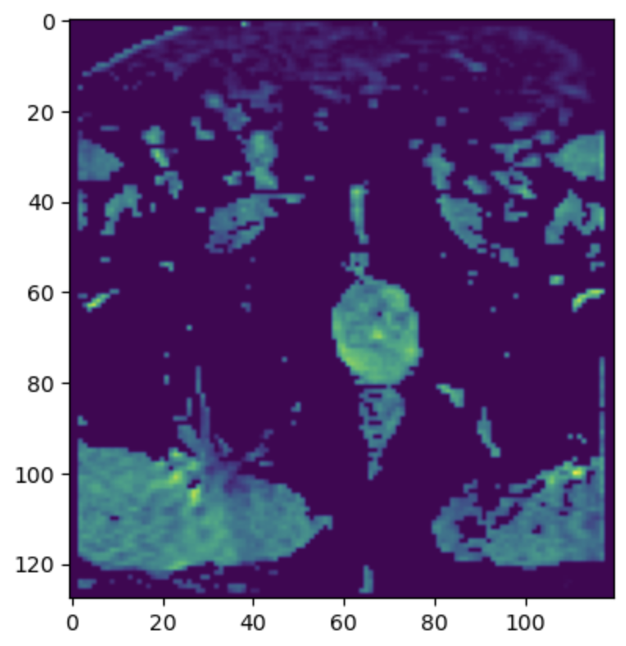
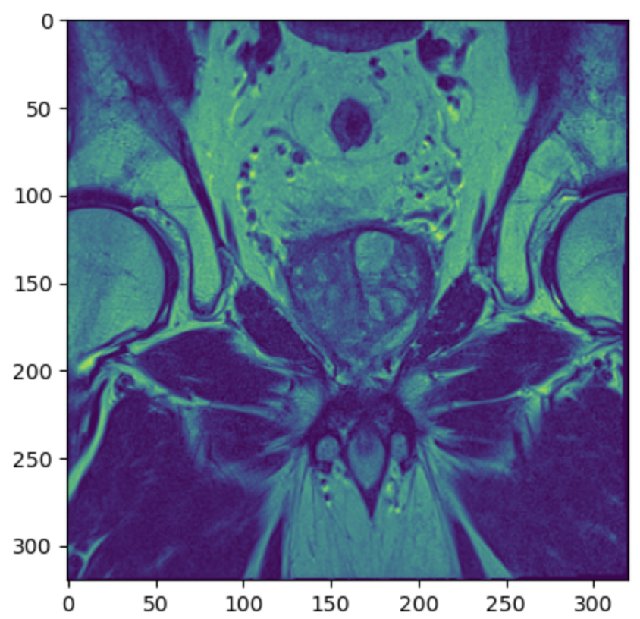


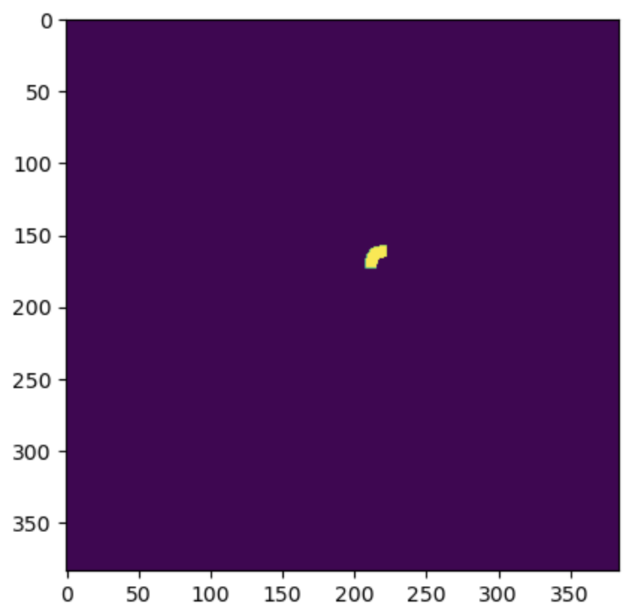


Dataset
Data source: Prostate Imaging: Cancer AI challenge (PI-CAI) hosted by Grand Challenge [1]
1500 case studies and 1476 unique patients
MRI images
ADC
T2W
HBV
SAG
COR
1 case study
Radiologist annotated images
Clinical Report
ADC
T2W
[1] https://pi-cai.grand-challenge.org/

Slide 4
Dataset
Data source: Prostate Imaging: Cancer AI challenge (PI-CAI) hosted by Grand Challenge [1]
1500 case studies and 1476 unique patients
MRI images
ADC
T2W
HBV
SAG
COR
1 case study
1290 case studies with both ADC and T2W annotation
Radiologist annotated images
Clinical Report
ADC
T2W
[1] https://pi-cai.grand-challenge.org/

Slide 5
Methodology - Preprocessing
Different images sizes and number of dept for each patient
Depth of each case treated as individual image
Resize to (128, 128) for uniformity
Repeat first channel 3 times for (128, 128, 3) shape
Final Input Shape
ADC:
(27,342, 128, 128, 3)
T2W:
(29,328, 128, 128, 3)
Input
ADC
T2W
Annotated image size matches their corresponding MRI images
Binary Label
ADC: (27,342, )
3.71% Positive Label
T2W: (29,328, )
4.35% Positive Label
Depth of each case treated as individual label
Binary labels for presence/absence of prostate cancer
Annotated Label
ADC
T2W

Slide 6
Methodology - Model
70% Train
15% Validation
15% Test
VGG19 Base Model
1. No reweighting, headless
2. Reweights, headless
3. Reweights, retraining last block
4. Reweights, retrain entire model
5. Augmented data, reweights, headless
6. Augmented data, reweights, retrained last block
ADC:
Input & Label
T2W:
Input & Label
Binary Cross Entropy
ADAM optimizer

Slide 7
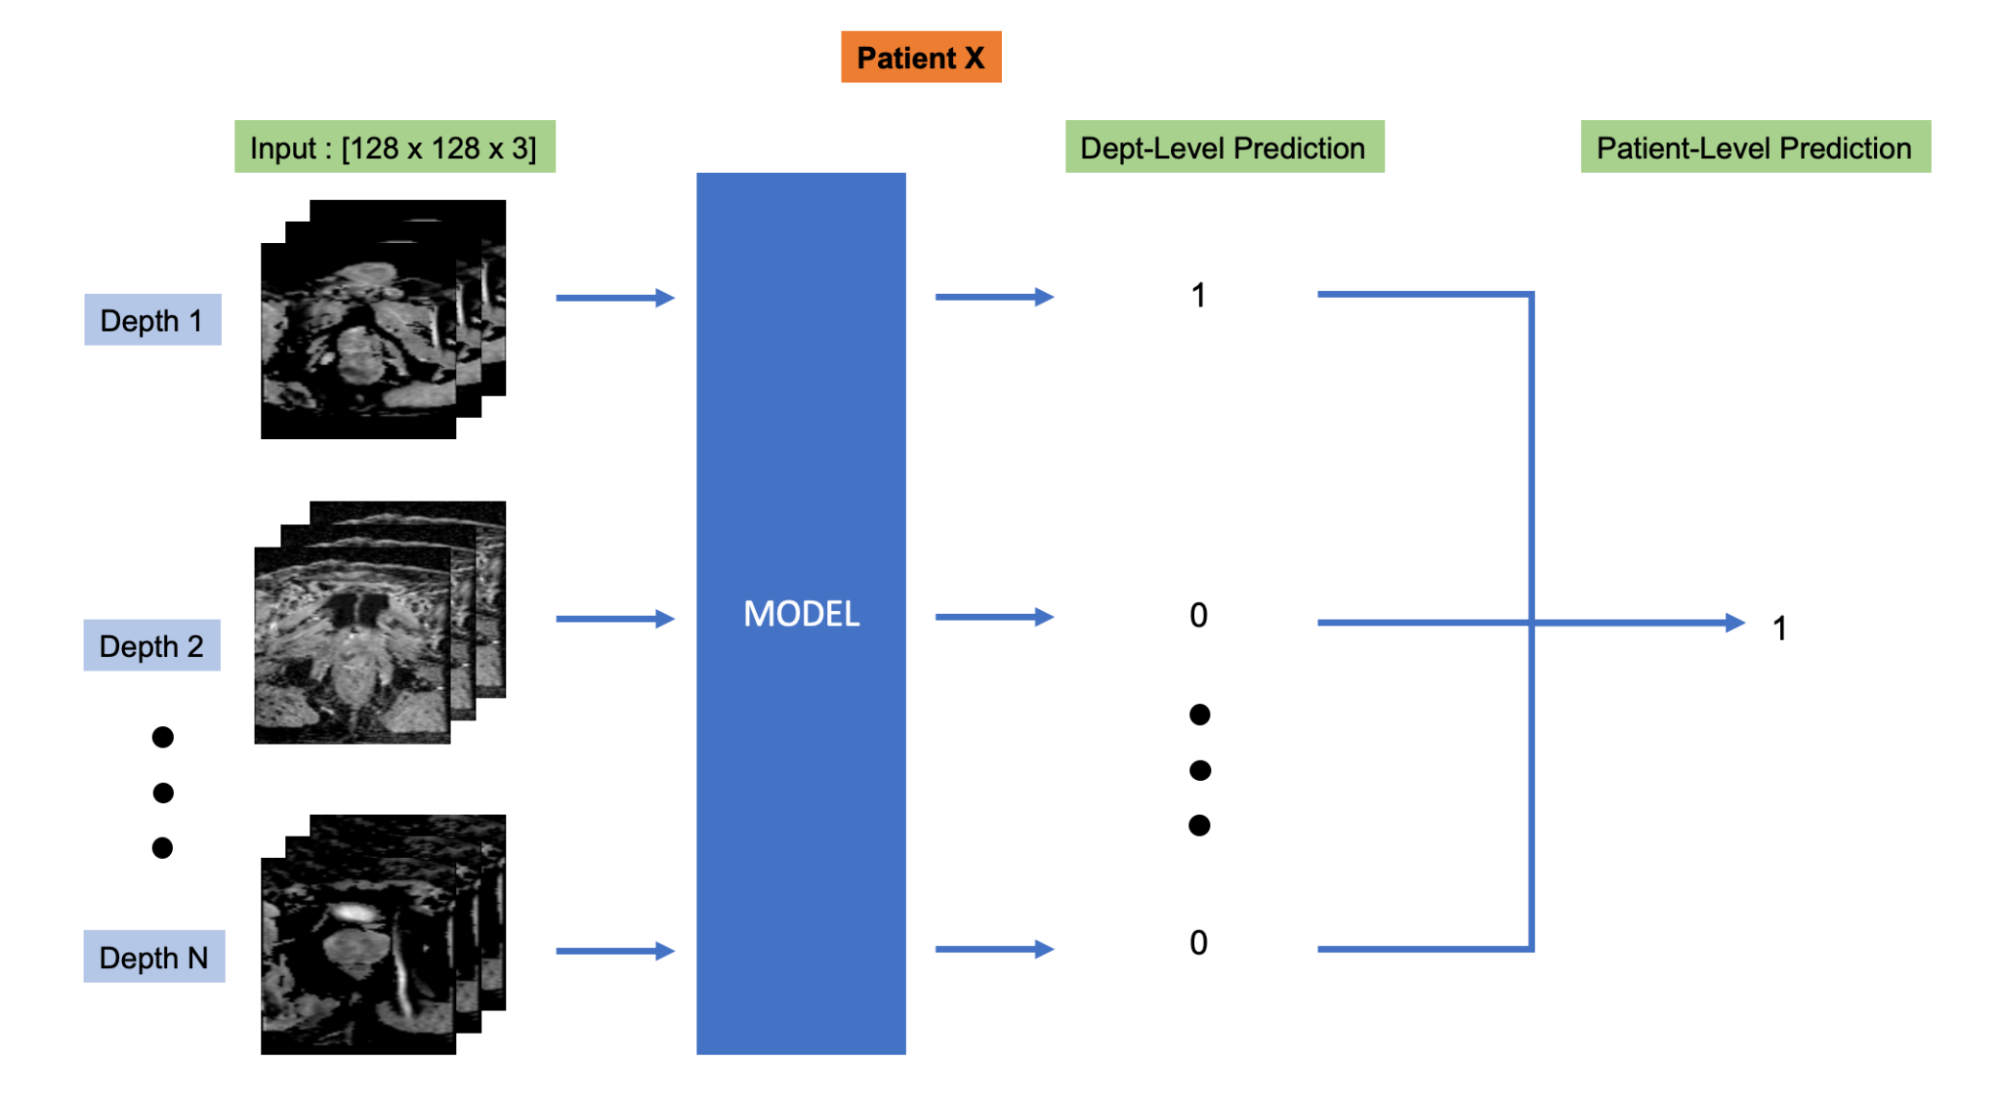

Methodology - Prediction

Slide 8
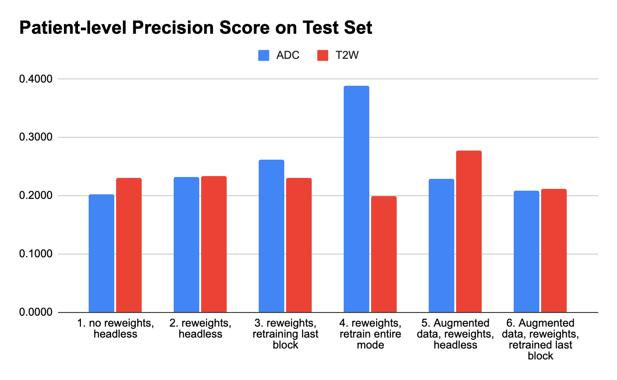
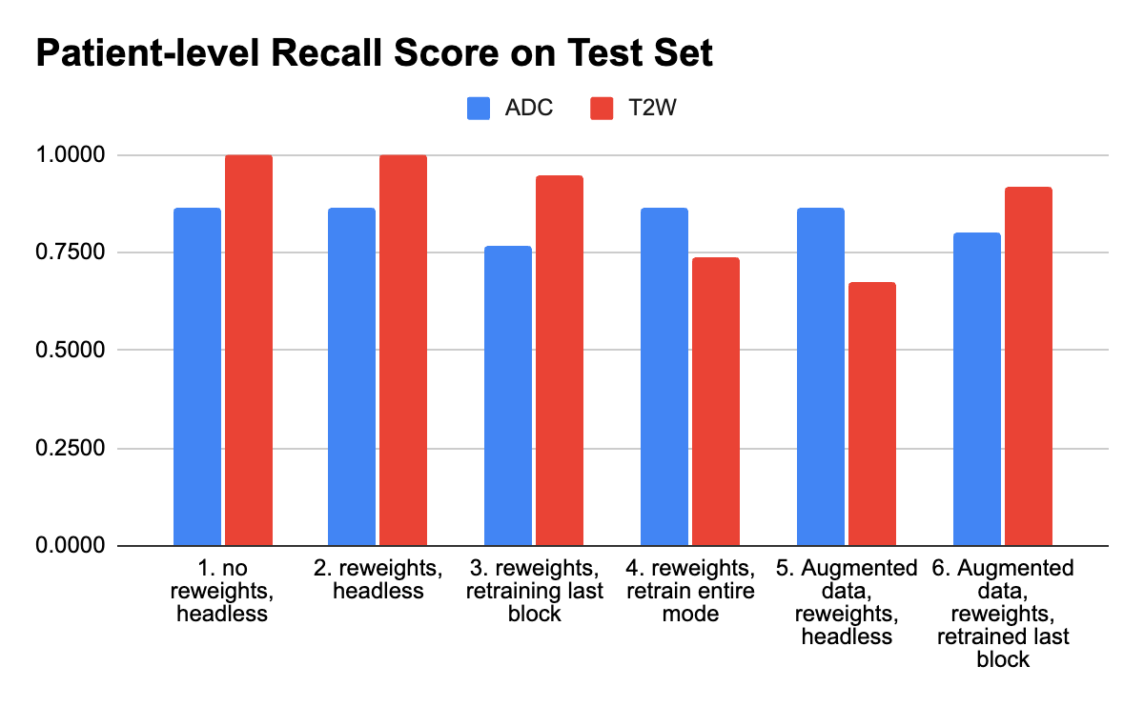
Result
Precision
Recall
Low precision, high recall

Slide 9
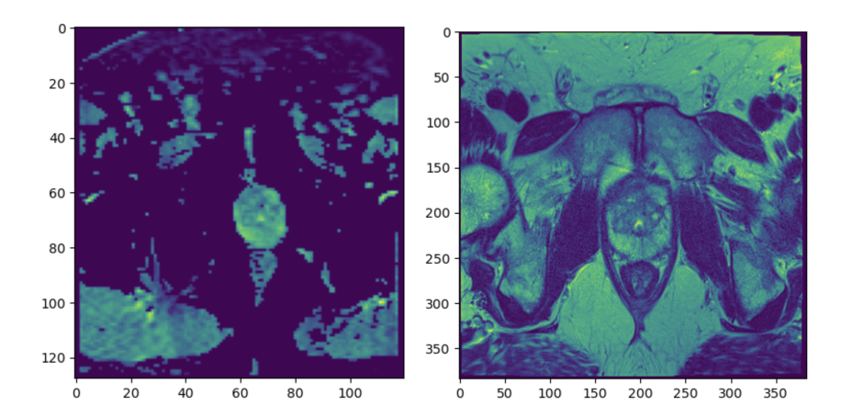
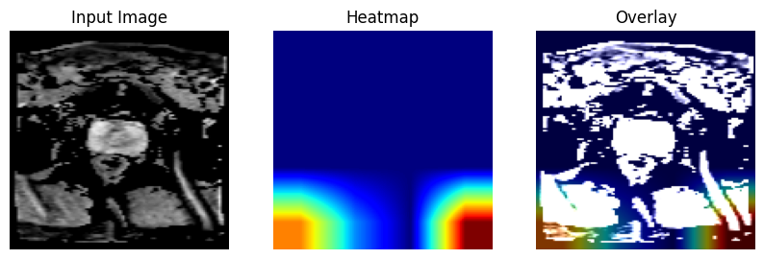
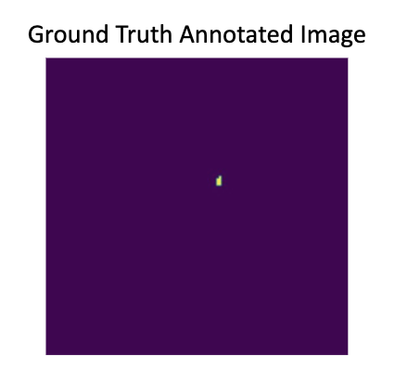
Discussion
ADC
T2W
Observation
No significant performance gains in using augmented data
Depth-level T2W performed slightly better than ADC
Recall for T2W fine-tuned last block is higher than retrained entire model. Reverse for ADC.
Simple Baseline Model - comparing between using 2 modalities and 1 modality.
GradCAM (Gradient Class Activation Map) - model unable to hone in on cancerous regions

Slide 10
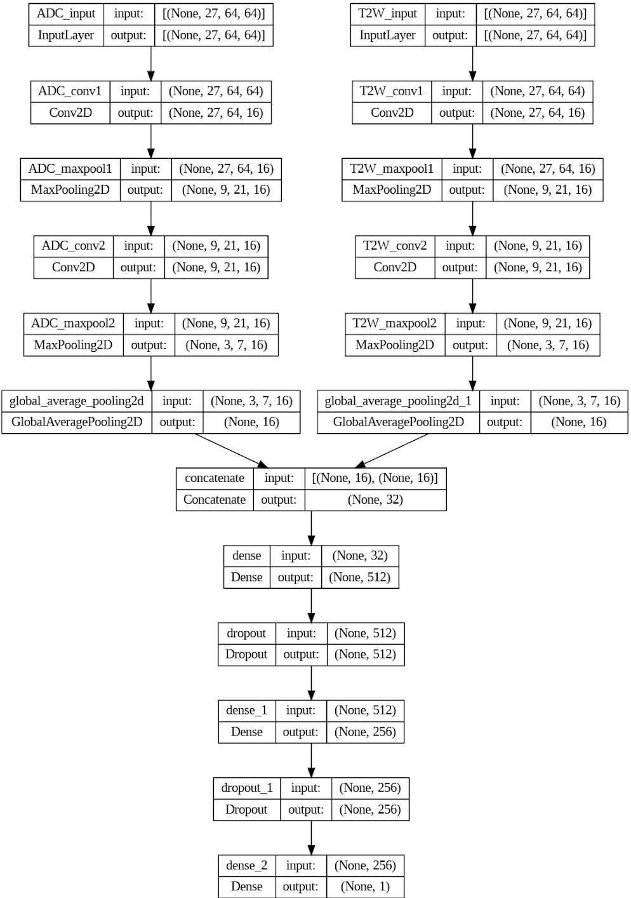
Baseline
Combines both ADC and T2W image modalities
Testing metrics
Precision: 0.297
Recall: 0.900
More information and shared burden of feature learning across two image modalities

Slide 11
Next Step
Exploration and comparison of different model architectures:
UNET → A commonly employed model architecture for medical diagnosis
3D Models → More comprehensive analysis, considering spatial information
Vision Transformers → Attention mechanisms to attend to specific patches
Potential extensions to address common issues clinician faces:
Cancer Grade Classification: Prostate cancers are graded on a scale of 0 to 5 (ISUP grading), with 5 being the most severe prognosis.

Slide 12
Thank you!
Yen Hann Yoo, Jessie Tanaboriboon

